Slide 1
Unit Six
Internal Developments and External Relations in Ethiopia and the Horn, 1800-1941

Slide 2
6.1. Nature of Interactions Among the Peoples and States of Ethiopia and the Horn
This section deals with two major issues:
  In the 19th century, independent states were formed in south central, southwestern and western parts of Ethiopia, contributing to ensuing political and economic developments.
  In the 19th century, long distance trade flourished in Ethiopia and the Horn, economically linking territories of the region and increasing interaction among diverse peoples of the region.

Slide 3
6.1.1. People’s and States in South-Central, Southwestern, and Western Ethiopia
Qabena:
Emerged as a powerful political entity in the second half of the 19th-century.
Emerged in south-central Ethiopia, northeast of the Gibe River.
Became a centre of Muslim revivalist movement, spreading Islam in the region.
Muslim refugees from Wollo, with possible Mahdist influence from Sudan, played a key role in the revival.

Slide 4
The Five Gibe States:
Were monarchical states emerged in the early 19th century among Mecha Oromo of the southwest.
The weakening of the Gadaa system led to the emergence of these states.
The war leaders (Abba Dula) played a role in the emergence of monarchies
  Turned themselves into hereditary leaders (moti) by controlling the long distance trade.
The five Gibe states were: Limmu Enarya, Guma, Gomma, Jimma and Gera.

Slide 5
Limmu Enarya:
Was established by Bofo/Abba Gomol (r. 1800-1825)
Limmu Enarya reached its zenith under Ibsa/Abba Bogibo (r. 1825-61) – Bofo’s son and successor
Under Ibsa, Limmu Enarya expanded its territories by incorporating others
Ibsa was succeeded by Abba Bulgu (r. 1861-1883)

Slide 6
Guma:
Jilcha Abba Bal’o started the formation of the state of Guma
Jilcha was succeeded by his son, Oncho (r. 1810-1830), who completed the state formation
Oncho was succeeded by Jawwe (r. 1840-1854)

Slide 7
Gomma:
Was established by Abba Boke (1800-1829)
Abba Boke was succeeded by Abba Mano (1829-1840)
Abba Mano supported Muslim scholars (Ulama)
The Ulama converted the people of Gomma into Islam much earlier than other Gibe states

Slide 8
Jimma:
An influential woman called Makahore emerged at Oda Hule in the late 18 century
  But did not become a monarch over Jimma.
Ose Kobi/Abba Faro became the first monarch, succeeded by Dangila/Abba Magal.
The formation of the state of Jimma was completed by Sanna/Abba Jifar I (r.1830-1855).

Slide 9
Jimma:
The kings that ruled Jimma after Sanna were:
  Abba Rebu (r. 1855-1859)
  Abba Boqa (r. 1859-1861)
  Abba Gomol (r. 1861-1875)
  Abba Jifar II (r. 1875-1935)
The most famous monarch of Jimma was Abba Jifar II.
The state of Jimma had iron mining centre at Dakkano and iron smelting centre at Kitto.

Slide 10
Gera:
Tullu Gunji (r. 1835-1838) completed the formation of the state of Gera
Tullu Gunji was succeeded by Abba Rago I (r. 1838-1848).

Slide 11
In general the Gibe states:
Levied taxes on farmers, and collected taxes on each crop.
  The gada system did not levy any tax.
  Levying tax came after the emergence of monarchical systems.
Used traditional instruments to measure the tax payments:
  Buchano (15 kilograms)
  Later Guboo (25 kilograms)

Slide 12
Had the following monarch officials:
  Abba Gurmu (next to the king)
  Abba Mizan (treasurer and foreign affair minister)
  Abba Dango (immigration chief)
  Lammi (envoy)
  Abba Qoro (district governor)
  Abba Ganda (village chief)
  Abba Busi (tax head)
  Abba Jiga (murder case judge)
  Abba Qawe (body guard)

Slide 13
The Leqa States:
Were monarchical states among Mecha Oromo of western Ethiopia
The decline of the gada system led to their emergence.
Leqa Naqamte:
Founded by Bakare Godana in 1840
Reached its height under Kumsa Moroda (later Dejjazmach Gebre-Egzi’abher)
Kumsa Moroda promoted handicraft, gold washing, coffee planting and game reserves.

Slide 14
Leqa Qellam:
Founded by Tullu with its centre at Gidami
Became powerful state under Jote Tullu
Jote consolidated his state controlling surrounding areas such as Seyyo (Dambi Dollo).

Slide 15
The State of Ilu
Emerged in the early 19th century in western Ethiopia
Founded by Chali Shono (Abba Bor)

Slide 16
Nilotic Sheikdoms:
These Sheikdoms were: Asosa or Alqodi, Bela/Beni-Shangul, Khomosha, Guba.
The influence of Islam and cross border trade was key in their emergence.
Their economic base – agriculture, gold mining and frontier trade.
Gold of the sheikhdoms attracted foreign powers – Egyptians and Mahdists.

Slide 17
Long distance trade flourished in the 19the century partly due to revival of external trade in the Red Sea region.
Two major routes originating from southwest Ethiopia linked territories of the Horn, serving as a medium of interaction among peoples of the region.
  One route connected southwest Ethiopia to northern Ethiopia – further to Sudan and the Red Sea.
  The other route connected southwest Ethiopia to eastern Ethiopia – further to the Gulf of Eden and Indian Ocean.
6.1.2. Trade and Trade Routes ( Long Distance Trade)

Slide 18
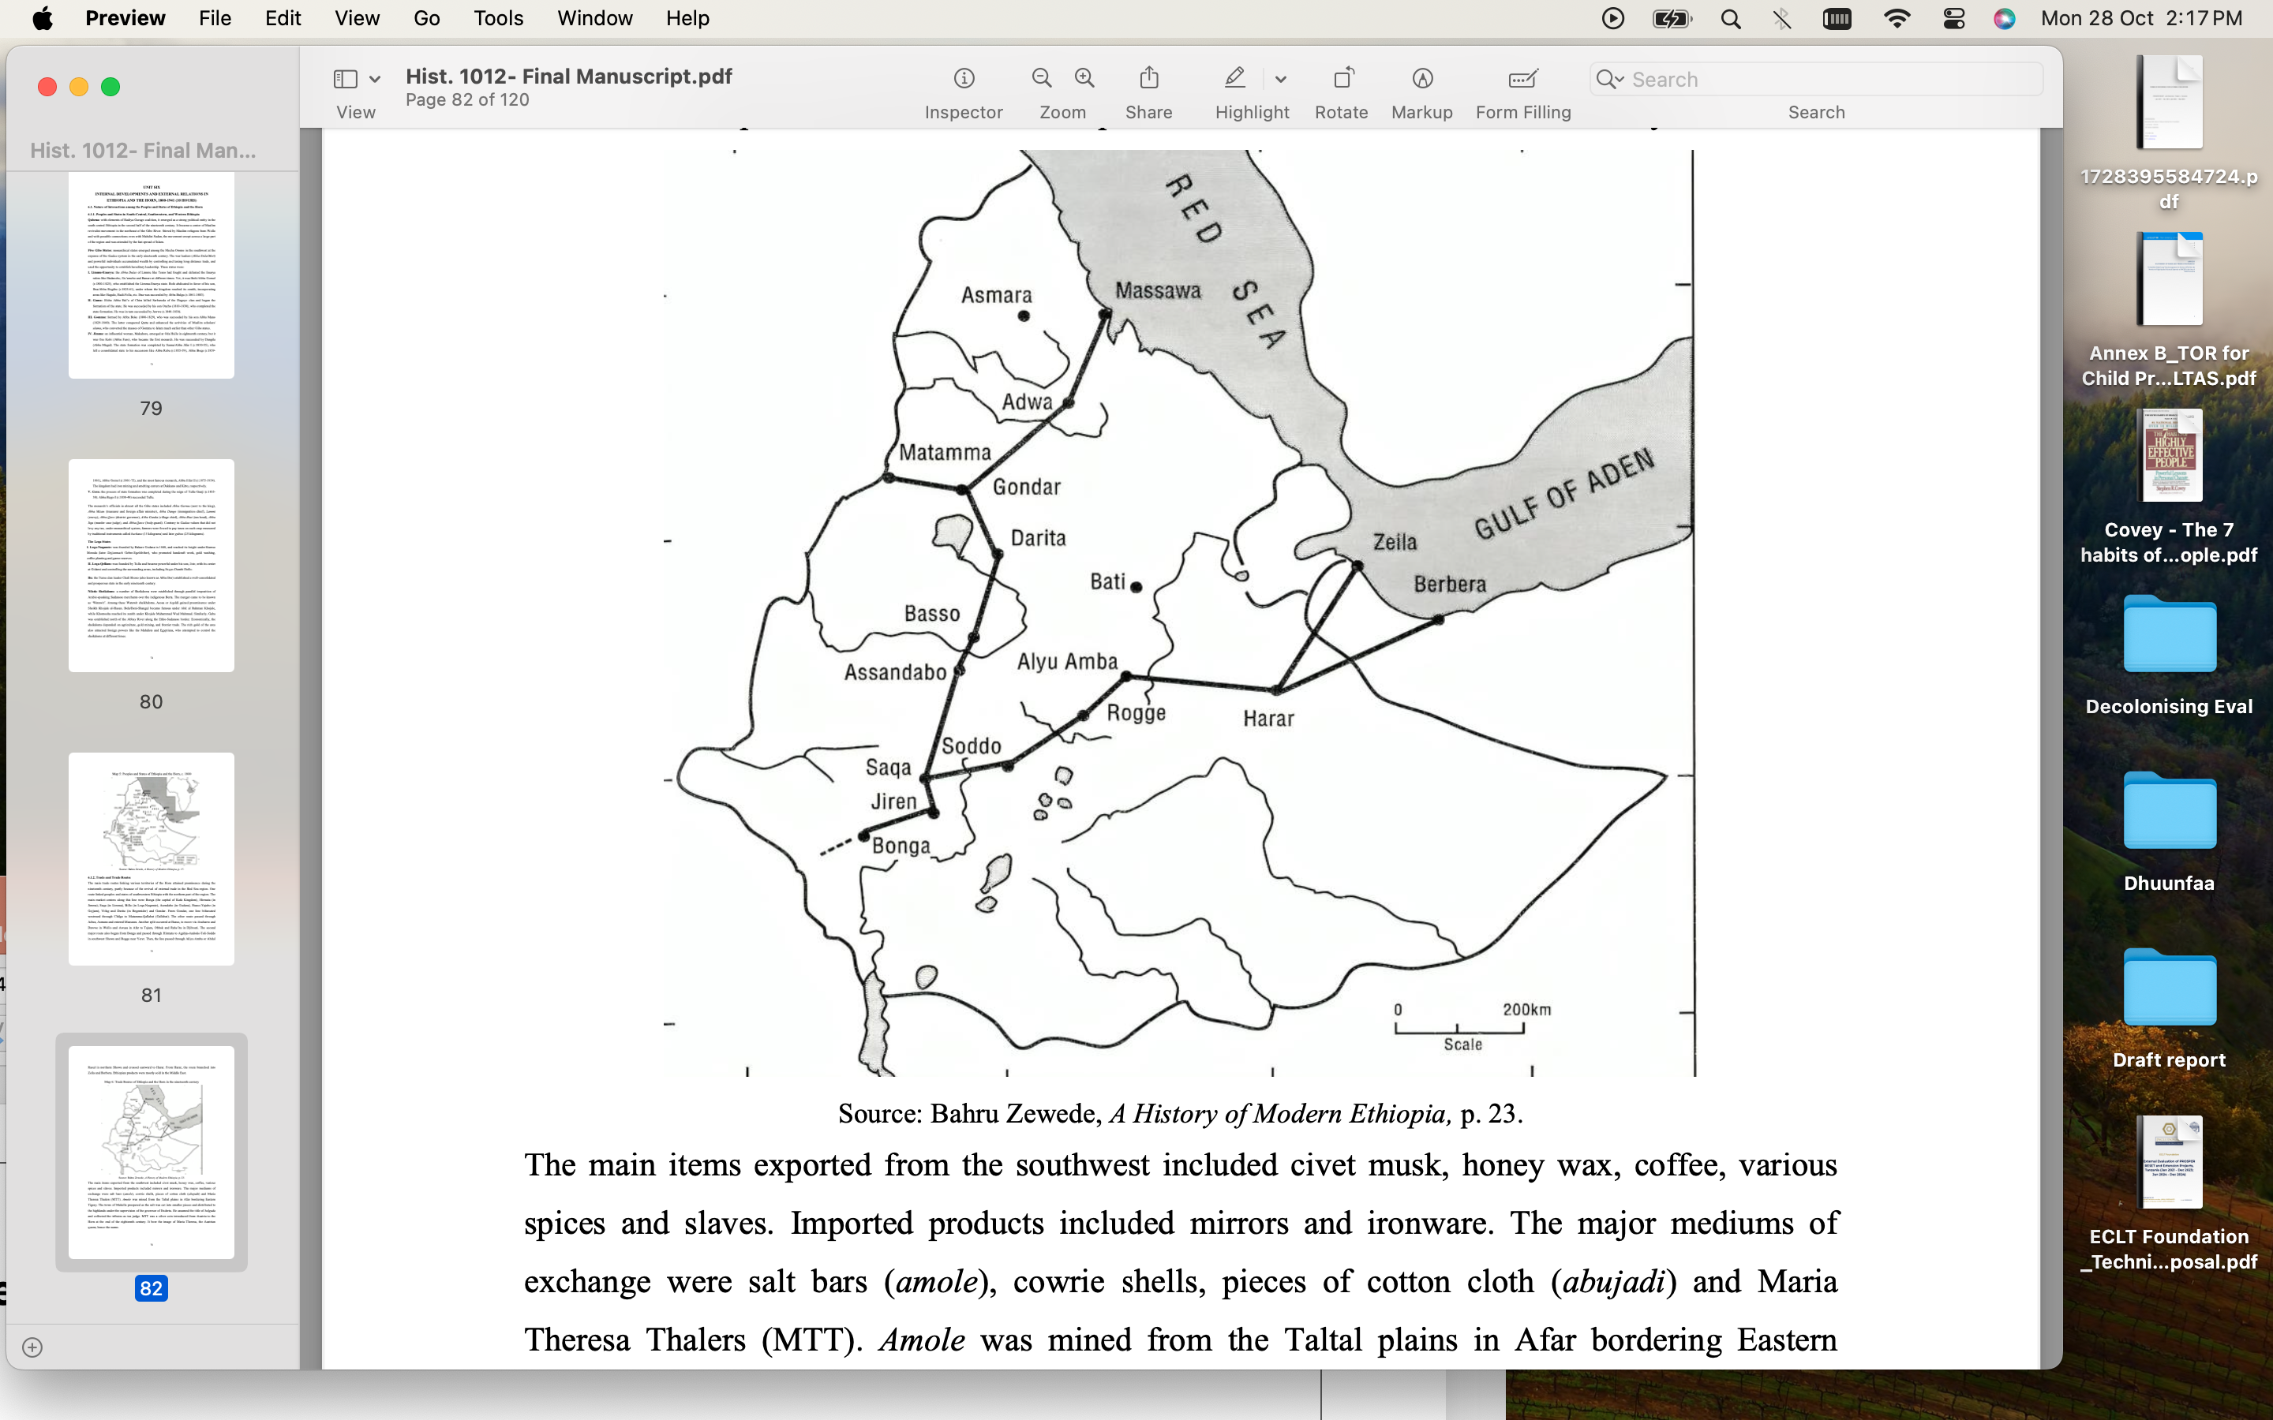
6.1.2. Trade and Trade Routes (Long Distance Trade)

Slide 19
Exports – civet musk, honey wax, coffee, slaves, spices
Imports – mirrors and ironware
Medium of exchange – salt bars (amole), cowrie shells, pieces of cloth (abujadi), and Maria Theresa Taler (MTT)
  The source of Amole was the Afar plains and it was cut into pieces and distributed to the Ethiopian highlands by the governor of Enderta, thereby prospering Mekelle.
  MTT was an Austrian coin that bore the image of Maria Theresa, Austrian queen.
6.1.2. Trade and Trade Routes (Long Distance Trade)

Slide 20
Traders - Muslims were the most active in the long distance trade
  Afqala - The Muslim merchants of the southwest
  Jabarti - The northern Muslim merchants
  Jallaba – The Sudanese merchants
  The Argobba were active on the eastern route, trading via Harar up to the Northern Somali Coast
6.1.2. Trade and Trade Routes (Long Distance Trade)

Slide 21
This section deals with historical events that led to the making of the modern Ethiopian state.
  The end of the Zemene Mesafint in 1855 marked the beginning of the process of making the modern Ethiopian state.
  Tewodros II brought the divided provinces of the Zemene Mesafint under one administration, and Yohanned IV maintained it.
  Menelik II launched massive territorial expansion to the south, culminating in the formation of the modern Ethiopian state as we know it today.
6.2. The Making of the Modern Ethiopian State

Slide 22
Process of Territorial Unification:
Ras Kassa Hailu of Qwara (later Tewodros II) fought four major battles and defeated regional lords of the time, initiating the process of making the modern Ethiopian state:
  The battle of Guramba (November, 1852) – defeated Dejjach Goshu of Gojjam
  The battle of Gorgora Bichen/Taqusa (April, 1853) – defeated Birru Aligaz, Aben, Yazew and Belew
  The battle of Ayshal (June, 1853) – defeated Ras Ali II
  The battle of Deresge (February, 1855) – defeated Dejjach Wube of Simen and Tigray

Slide 23
Process of Territorial Unification:
Immediately following his victory at the battle of Deresge, Kassa Hailu was crowned as Tewodros II by Abune Salama – February, 1855.
Tewodros II marched to Wollo and Shewa to consolidate his power by appointing administrators accountable to him.
However, Tewodros II was not able to rule in peace and implement his reforms
  There were internal resistance to his rule from Gojjam, Simen, Walqyit, Wollo and Shewa
  His imprisonment of Europeans led to a British military expedition and the defeat of his army at Maqdela in 1868, leading to his committing of suicide.

Slide 24
Process of Territorial Unification:
Though Tewodros did not succeed in implementing his reforms, he established a ground work for his successors.
Following the death of Tewodros, three persons emerged as contenders to the throne:
  Wagshum Gobeze Gabramadhin of Lasta
  Bezbez Kassa Mircha of Tigray
  Meneilek of Shewa
Wagshum Gobeze took throne as Tekle Giyorgis II and ruled from 1868 to 1871.

Slide 25
Process of Territorial Unification:
Kassa Mircha fought and defeated Tekle Giyorgis at the battle of Assam in July, 1871.
Following his victory at the battle of Assam, Kassa Mircha was crowned as Yohannes IV in January 1872.
Yohannes IV introduced decentralized system of administration, permitting regional rulers to exercise considerable autonomy.
The following cases are examples of his approach to decentralized administration:
  He recognized Menilek as negus of Shewa by Liche agreement in 1878.
  He designated Ras Adal Tesema of Gojjam as negus Tekle Haimanot of Gojjam and Kafa in 1881.

Slide 26
Process of Territorial Unification:
Yohannes IV called the Council of Borumeda in 1878 to end religious controversy within the EOC and to bring religious uniformity in the country
The decisions of the Boru Meda Council:
  Tewahedo was declared the only doctrine of the EOC.
  Muslims and adherents of other religions should convert to Orthodox Christianty

Slide 27
Process of Territorial Unification:
The Wollo Muslims reacted to the decision of the Council of Borumeda in different ways:
  Leading Wollo leaders such as Mohammed Ali and Amede Liben converted to Christianty taking the names Ras Mikael and Dejjach Hayle-Maryam, respectively – rather reluctantly
  Others accepted the emperor’s demands outwardly but remained Muslims, becoming “Christians by day and Muslims by night”
  Some fled to Arsi, Gurage, Jimma and Sudan
  Still others revolted under the leadership of Sheikh Tolla (Talha) Jafar but faced retributive measures.

Slide 28
Process of Territorial Unification:
Emperor Yohannes died at the battle of Metemma in 1889.
Though Yohannes designated his son, Mengesha Yohannes, as his successor, he did not came to power.
Menilek of Shewa assumed power because he became powerful due to the resources he amassed in the course of his territorial expansion.
Negus Menilek of Shewa was crowned as emperor Menilek II (r. 1889-1913), and Ras Mengesha Yohannes was appointed as governor of Tigray.

Slide 29
Territorial Expansion:
Menilek of Shewa successfully conducted massive territorial expansions to the south because:
  He had access to modern firearms
  He controlled resource rich areas that enabled him to build his military muscle
  He had dedicated generals

Slide 30
Territorial Expansion:
Menilek’s territorial expansion to the south can be divided into three phases:
  When he was king of Shewa (1865-89)
  From his coronation to the battle of Adwa (1889-1896)
  The Adwa aftermath (1896-1900)
Some people submitted to Menilek while others resisted

Slide 31
Territorial Expansion:
Tulama and Eastern Mecha Oromo:
Were incorporated before the 1870s after controlling local leaders:
    Ashe rufo of Salale
    Dula Ara’e of Gulale
    Tufa Muna of Gimbichu
    Ture Galate of Soddo
  Notable Oromo leaders from this region who helped Menilek’s process of expansion were
    Ras Gobana Dache
    Fitawrari Habte-giorgis Dinagde,
    Dejjach Balcha Safo (Abba Nefso)

Slide 32
Territorial Expansion:
Gurage:
Northern Gurage (Kistane) peacefully submitted to Menilek form 1875-76 because of
  Their religious affinity to the Kingdom of Shewa
  Geographical proximity to the kingdom of Shewa
  Fear of the surrounding Oromo
The western Gurage resisted Menilek’s forces under Hasan Enjamo of Qabena.
Ras Gobana Dache broke the resistance of Western Gurage.

Slide 33
Territorial Expansion:
Mecha/Western and Southwestern Oromo
Adal Tesema of Gojjam controlled Horro Guduru since the mid 1870s
  Initially, Moti (king) Habishe Garba of Horro crushed Adal’s forces at Choman.
  However, Adal’s forces ambushed Habishe at Kokor, resulting in Gojjam’s control of the area until June 6, 1882.
  Menilek of Shewa defeated Gojjam’s forces at the battle of Embabo in Horro Guduru on June 6, 1882.
Following Menilek’s victory at the battle of Embabo, Leqa Naqamte, Leqa Qellem and Jimma Aba Jifar peacefully submitted to Menilek in return for recognition of their autonomy

Slide 34
Territorial Expansion:
Mecha/Western Oromo
On the other hand, several notables of the Mecha Oromo of the West formed coalition and defeated Menilek’s army led by the Nadew brothers (Dasta, Dilnesaw, and Tesemma) at the battle of Gara Dobi. These were:
      Garbi jilo of Leqa Billo
      Tucho Dano of Leqa Horda
      Ligdi Bakare of Leqa Naqamte
      Genda Busan of Sibu Sire
      Mardasa Konche of Nonno Migira
      Turi Jagan of Nonno Rogge

Slide 35
Territorial Expansion:
Mecha/Western Oromo
An alliance of Wachu Dabalo of Sibu, Jorgo Dagago of Noole Kabba, and others fought Menelik’s local allies like Moroda and Amante Bakare at Sambo Darro.
Firissa of Guma fought Menelik’s army from 1889 to 1901.
Abba Bosso of Gomma resisted Menilek’s expansion but defeated by Demisew Nesibu in early 1900.
Fatansa resisted Menilek’s forces at Qarsa Gogila but finally defeated by Ras Tesemma Nadew’s forces, who incorporated Ilu Abba Bor.

Slide 36
Territorial Expansion:
Arsi Oromo:
Menilek fought the most sustained and bloody war against the Arsi, conducting six campaigns between 1882 to and 1886.
In their resistance, the Arsi were led by many notables – Sufa Kuso, Damu Usu, Lenjiso Diga, Gosa Dilamo, and Roba Butta
Initially, the Arsi defeated Menilek’s forces at Dodota and Qal’ata
Ras Darge Sahle-Silassie’s force defeated the Arsi at the battle of Azule in 1886.
The defeat of the Arsi was followed by the Anole incident of the 1887.

